Slide 1
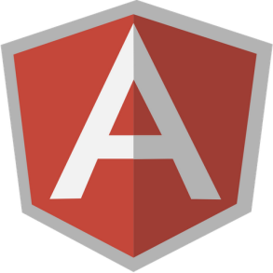




Angular JS and Java (Spring, Struts and Hibernate) …?
Hey All,
I am
Preetam Dwivedi

Slide 2

What is “Angular JS” ?
AngularJS is an open-source JavaScript framework, maintained by Google, that assists with running single-page applications. Its goal is to augment web-based applications with model–view–controller (MVC) capability, in an effort to make both development and testing easier.
AngularJS allows the developer to specify custom and reusable HTML tags that moderate the behavior of certain elements these attributes are called ‘Diretives’. Example: ng-app , ng-model etc.

Slide 3
Why “Angular JS” ?
Defines various ways to organize web app at client side.
Enhances HTML using various directives, attributes and templates.
Encourage 2-way data binding
Encourage MVC
Code reuse
Good for SPAs

Slide 4
Angular JS: MVC
View
Controller
Model
3. Implements the business
Logic on response data
and bind it to view
Event or User Action
or View Load
2. Maps to particular model
after fetching the data

Slide 5
Angular JS: Core Concepts
Bootstrap
Data Binding
Directives
Expressions
Filters
Controllers
Dependency Injection
Views and Routing
Services
$digest

Slide 6
Angular JS: Bootstrap
<!doctype html>
<html lang="en" ng-app>
<head>
<meta charset="utf-8">
<title>My HTML File</title>
<script src="angular.js"></script>
</head>
<body>
…..
</body>
</html>
The ng-app attribute represents an Angular directive named ngApp.
The ngApp found in the document will be used to define the root element to auto-bootstrap as an application.

Slide 7
What happens during bootstrapping..?
There are 3 important things that happen during the app bootstrap:
The injector that will be used for dependency injection is created.
The injector will then create the root scope that will become the context for the model of our application.
Angular will then compile the DOM starting at the ngApp root element, processing any directives and bindings found along the way.

Slide 8
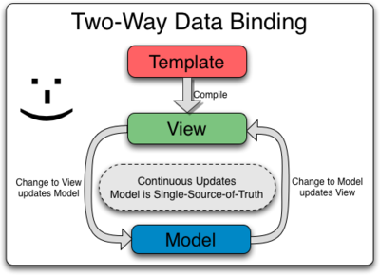
Angular JS: Data Binding
Data-binding in Angular web apps is the automatic synchronization of data between the model and view components.
First the template (uncompiled HTML) is compiled on the browser, and second, the compilation step produces a live view.

Slide 9
Angular JS: Directives
I am ng-model and i am a directive.
<input ng-model=“hell">
Directives are markers on a DOM element (such as an attribute, element name, or CSS class) that tell AngularJS's HTML compiler ($compile) to attach a specified behavior to that DOM element or even transform the DOM element and its children.
Angular provide some in-built directives like ngApp(ng-app), ngModel(ng-model), ngIf(ng-if) etc.

Slide 10
Angular JS: Directives…
Do I need to get compiled…?
<input ng-model=“hell">
What does it mean to "compile" an HTML template?
For AngularJS, "compilation" means attaching event listeners to the HTML to make it interactive. The reason the term "compile" is used that the recursive process of attaching directives mirrors the process of compiling source code in compiled programming languages.

Slide 11
Angular JS: Expressions
I am an expression. I use $parse service to evaluate.
{{ expression }}
1+2=3
1+2={{1+2}}
Expression evaluation is forgiving to undefined and null.
It means that if any of a/b/c is null or undefined it will not throw exception and show nothing(blank).
{{a.b.c}}

Slide 12
Angular JS: Filters
I am a Filter. I will show up to 2 decimal points only i.e. 1.23
{{ 1.234 | number:2 }}
A filter formats the value of an expression for display to the user.
They can be used in view templates, controllers or services and it is easy to define your own filter.
{{ expression | filter }}
{{ expression | filter1 | filter2 | ... }}
{{ expression | filter:arg1 : arg2 ... }}

Slide 13
Its too much to remember.
Lets see an example.

Slide 14
Angular JS: Controllers
In Angular, a Controller is a JavaScript constructor function that is used to augment the Angular Scope.
When a Controller is attached to the DOM via the ng-controller directive, Angular will instantiate a new Controller object, using the specified Controller's constructor function. A new child scope will be available as an injectable parameter to the Controller's constructor function as $scope.
I am a controller. I contain all business logics.
<div
ng-controller=“hellCtrl">
{{msg}}
</div>
function hellCtrl($scope)
{
$scope.msg = ‘Hell!!!';
}

Slide 15
Angular JS: Controllers…
function hellCtrl($scope)
{
$scope.msg = ‘Hell!!!';
}
Please use me correctly.
Do not use Controllers for:
Any kind of DOM manipulation — Controllers should contain only business logic.
Input formatting (use angular form controls instead).
Output filtering (use angular filters instead).
Sharing stateless or stateful code across Controllers(use angular services instead).
Managing the life-cycle of other components (for example, to create service instances).

Slide 16
Angular JS: Dependency Injection
$scope and hellSvc are two services which need to be injected into the controller.
function hellCtrl($scope, hellSvc)
{ ... }
Dependency Injection (DI) is a software design pattern that deals with how code gets hold of its dependencies.
There are only 3 ways an object or a function can get a hold of its dependencies:
The dependency can be created, using the new operator.
The dependency can be looked up by referring to a global variable.
The dependency can be passed in to where it is needed.

Slide 17
Angular JS: Views and Routing
Sample App Router Config
var app= angular.module(‘app', [
'ngRoute‘, ‘appCtrl’ ]);
app.config(['$routeProvider',
function($routeProvider) {
$routeProvider.when('/home',
{
templateUrl: 'partials/home.html',
controller: ‘homeCtrl'
}).otherwise({
redirectTo: '/error’ });
}]);
$route is used for deep-linking URLs to controllers and views (HTML partials). It watches $location.url() and tries to map the path to an existing route definition.
Routing requires the ngRoute module to be installed.
We can define routes through $routeProvider’s API.

Slide 18
Angular JS: Services
What are Angular Services?
Angular services are singletons objects or functions that carry out specific tasks common to web apps. Angular has a number of built in services, such as the $http service.
Using $inject for injection
var ctrl= function($location) { ... };
ctrl.$inject = ['$location'];
myModule.controller(‘ctrl', ctrl);
Using inline injection
var svc= function($http) { ... };
myModule.factory(‘svc', ['$http', svc]);

Slide 19
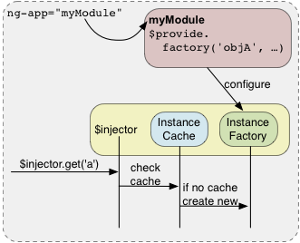
Angular JS: Services and DI xTended
app.config(function($provide) { $provide.factory('greeting', function() {
return function(name) {
alert("Hello, " + name);
};
}); });
var greeting = $injector.get('greeting'); greeting(‘Cloak’);

Slide 20
Angular JS: Creating Services
All services are defined by using $provider service and it’s respective methods provider, factory and service.
These methods are also available on the module object so you can use them without injecting $provider service.
Using angular module
var myModule = angular.module('myModule', []);
myModule.factory('serviceId', function() {
var inst;
…
return inst;
});
Using $provider service
angular.module('myModule', [], function($provide) {
$provide.factory('serviceId', function() {
var inst;
…
return inst;
});});

Slide 21
Angular JS: Creating Services…
Creating services using service. Service is suitable for cases when you have a ready function that you need to share throughout the app without any “preprocessing”. It expects to receive a constructor which it then invokes by using new and then returns a result.
Using service
angular.module(‘hell', []).service(‘hellService', function(){
this.greet = function (name) {
return ‘Welcome to Hell : ' + name;
}
});
function hellController( hellService) {
hellService.greet(‘Cloak’);
}

Slide 22
Angular JS: Creating Services…
Creating services using fatory. Factory allows us to add some logic before creating the object we require. It allows us to pass the function which factory then invokes and returns the result. This allows us to return what ever we like not just call constructor of already prepared function.
Using factory
angular.module(‘hell', []).factory(‘hellService', function () {
var hellClass = function(name) {
this.name = name; this.greet = function () {
return ‘Welcome to Hell: ' + this.name;
} } return hellClass ; });
function hellController( hellService) {
var hellSvc = new hellService(‘Cloak');
hellSvc.greet();
}

Slide 23
Angular JS: Creating Services…
Creating services using provider. Provider is the most configurable of all three. All other providers are derived from it. It enables us define how the service will be provided even before the injection system is in place. This is achieved with configure call where we register work during the modules configuration phase.
Using provider
var hellApp = angular.module(‘hellApp', []);
hellApp.provider(‘hell', function () {
var darkSide = true;
this.joinDarkSide = function(s){
darkSide = s;
}
var hellClass = function(name) {
this.name = name;
this.greet = function () { return ‘Welome to Hell(Dark Side):’ + this.name; } } ….contd…

Slide 24
Angular JS: Creating Services…
Contd..: Using provider
var hell2Class = function(name) { this.name = name; this.greet = function () { return ‘Welcome to Hell(Light Side) ' + this.name; } }
this.$get = function() {
if (darkSide){ return hellClass; }
else { return hell2Class; } };
});
hellApp.config(function(hellProvider){ hellProvider.joinDarkSide(false); });
function hellController( hellProvider) {
var luke = new hellProvider('Luke'); luke.greet();
}

Slide 25
Getting complex…?
lets see an example to understand the concepts better.

Slide 26
Angular JS: Digest
How all this works?
AngularJS compares a value with its previous value and if it has changed then a change event is fired. This is dirty checking.
In AngularJS, a digest is the cycle that performs dirty checking. This is initiated via $digest().
If something happens outside of AngularJS, you need to let AngularJS know to execute a digest cycle and you do that via $apply which calls $digest.

Slide 27
Angular JS: Digest…
$digest();
This is the heart-beat of angular js.
It processes all of the watchers of the current scope and its children.
The $digest()keeps calling the watchers until no more listeners are firing. This means that it is possible to get into an infinite loop. This function will throw 'Maximum iteration limit exceeded.' if the number of iterations exceeds 10.
Usually, we don't call $digest() directly in controllers or in directives. Instead, we should call $apply() (typically from within a directives), which will force a $digest().
If you want to be notified whenever $digest() is called, you can register a watchExpression function with $watch() with no listener.

Slide 28
Angular JS: Watch Expressions
Behind every $digest cycle is a good watchExpression. watchExpressions return the value of what is being watched on every $digest cycle. This is the trenches of dirty checking. If the value of the current watchExpression call and the previous watchExpression call do not match then a listener is fired.
Syntax:
scope.$watch('name', function(newValue, oldValue)
{ /* Do something clever here */ });

Slide 29
Angular JS: $apply
$apply is a courier service that the outside world can recruit to tell AngularJS that something has happened and drop off an optional expression to be handled.
To follow the courier analogy, $apply delivers the message and possibly a package to the sweet lady at the front desk named $evalerie, but you can call her $eval.
Now $eval checks to make sure that $apply dropped off a legitimate expression. If something is wrong while it is being evaluated then an exception is thrown and passed to the $exceptionHandler service. From there, $digest is called to kick off the $digest cycle.
Eg.: http://jsfiddle.net/simpulton/huKHQ/

Slide 30
Angular JS with Java
(Springs / Struts
/ Hibernate) : READER-APP

Slide 31
Reader-app : Design
The Reader App has been divided into five sub-projects: reader-util,
reader-services, reader-commons, reader-apis, reader-app. Now lets discuss each project in details to understand the design better.
reader-util ( Simple Java Classes )
reader-services ( Hibernate + Springs )
reader-commons ( POJO classes)
reader-apis ( Spring Controllers )
reader-app ( Angular JS + Struts + Spring )

Slide 32
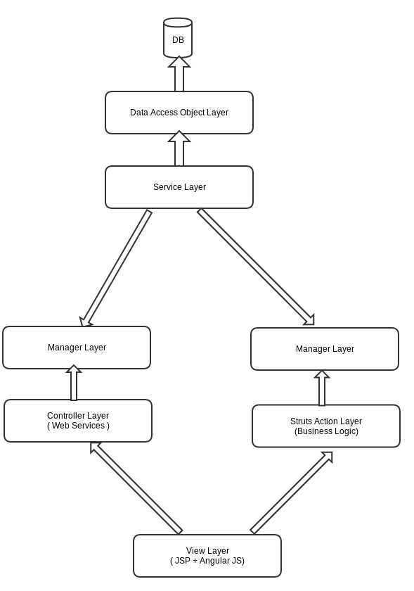
Reader-app : Design
reader-services
reader-apis
reader-app

Slide 33
Okay… lets see how it looks (running code…)

Slide 34
Thanks You !!!

